Slide 1
BoF: Practical Reproducibility by Managing Experiments Like Software
Chairs: Ivo Jimenez, Mike Heroux, Kate Keahey, Jay Lofstead, Carlos Maltzahn

Slide 2
Agenda
12:15 – Introduction (scoping the BoF)
12:25 – Lightning talks
Speakers: Kate Keahey, Carlos Maltzahn and Ivo Jimenez
12:40 – Discussion
1:05 – Survey
falsifiable.us/events/sc17_bof

Slide 3
Terminology_{[1]}
Can I re-run an experiment from a published paper?
Result Status | Artifacts | Re-executed By
Repeatability | Original | Original Author(s)
Replicability | Original | 3rd Party
Reproducibility | Re-implemented | Anyone
Easily
Can I do it in 30 minutes or less?
[1]: https://www.acm.org/publications/policies/artifact-review-badging

Slide 4
Common Experimentation Workflow
Code
Package
Execute
Output Data
Analyze/
Visualize
Manuscript
Input Data

Slide 5
Analogies With Modern SE Practices (aka DevOps)
Scientific exploration | Software project
Experiment code | Source code
Input data | Test examples
Analysis / visualization | Test analysis
Validation | CI / Regression testing
Manuscript / notebook | Documentation / reports

Slide 6
















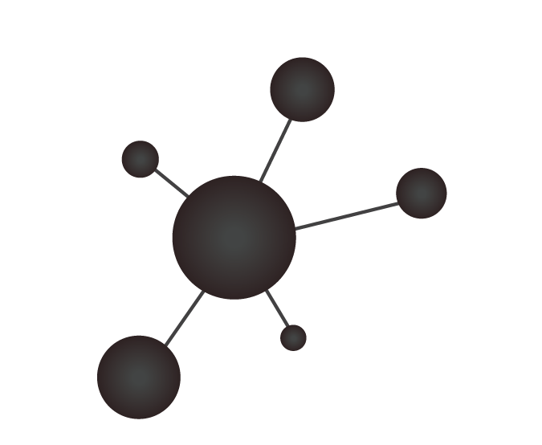







DevOps View of The Experimentation Workflow
Code
Package
Execute
Output Data
Analyze/
Visualize
Manuscript
Input Data

Slide 7
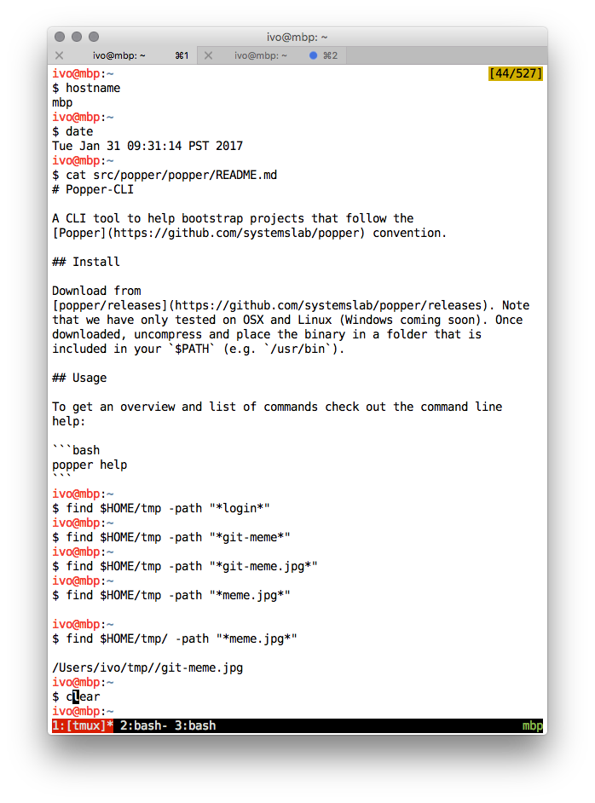


What is DevOps?
Typical
DevOps
myscript.sh
$ bash myscript.sh

Slide 8
Scope of This BoF
Automating all or some parts of a scientific exploration is possible today:
Test-beds such as Chameleon and CloudLab provide APIs to automate the reservation, configuration and tearing down of resources
Automatically going from source code to container (Docker/Singularity/Spack/VMs)
Execution can be automated
Results can be automatically validated
Sample of questions we want to address today:
How can we introduce DevOps into our practice?
What are the roadblocks in your domain to automating explorations?
What can we do as a community to make it easier (e.g., curated examples)?
What incentives can we create to encourage people to follow best practices?

Slide 9
Agenda
12:15 – Introduction (scoping the BoF)
12:25 – Lightning talks
Kate Keahey, Carlos Maltzahn, Ivo Jimenez
12:40 – Discussion
1:05 – Survey

Slide 10
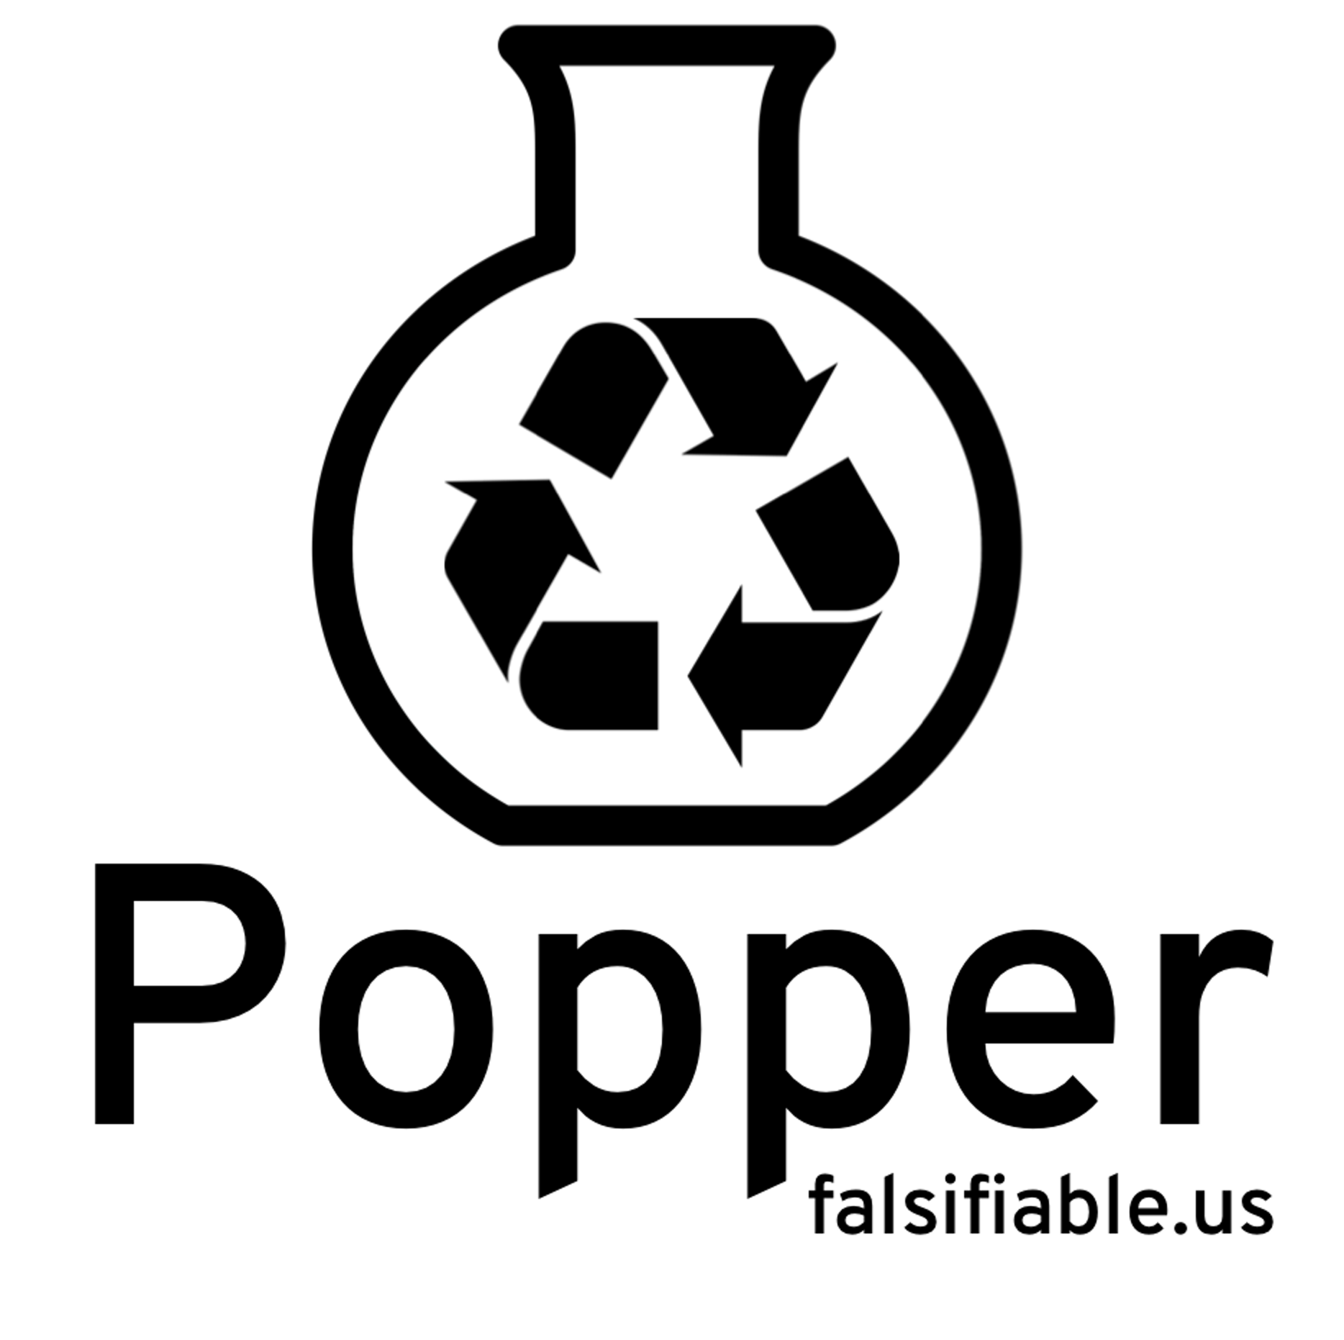
Practical Replicability Can Be Achieved Today
Pick one or more tools from the DevOps toolkit
Write scripts for an experiment pipeline
Put all scripts in a version control repository
[1]: Jimenez et al. Standing on the Shoulders of Giants by Managing Scientific Experiments Like Software, ;login: Winter 2016, Vol. 41, No. 4.
[2]: Jimenez et al. The Popper Convention: Making Reproducible Systems Evaluation Practical, REPPAR 2017.
Notes:
Upfront, at the beginning of the exploration, otherwise is costly to do it at the end

Slide 11
Popper
Make it super easy to automate execution and validation of experimentation pipelines
If it’s easy/low-overhead, it’s more likely it’ll be used
Common convention to organize the contents of a repo
CLI tool that helps users to implement pipeline stages
Provide domain-specific examples
Today: Genomics, MPI, Ceph, HEP
Looking for domain-experts to contribute more examples

Slide 12
mypaper/
├── experiments
│ ├── exp1
│ │ ├── README.md
│ │ ├── output
│ │ │ ├── exp1.csv
│ │ │ ├── post.sh
│ │ │ └── view.ipynb
│ │ ├── run.sh
│ │ ├── setup.sh
│ │ ├── teardown.sh
│ │ └── validate.sh
│ ├── exp2
│ │ ├── README.md
│ │ └── ...
│ └── exp3
│ ├── README.md
│ └── ...
└── paper
├── build-pdf.sh
├── figures/
├── paper.tex
└── refs.bib
Common convention to organize the contents of a repo

Slide 13
$ popper pipeline init myexp
-- Initialized exp1 pipeline.
$ ls -l pipelines/
total 20K
-rw-r----- 1 ivo ivo 8 Apr 29 23:58 README.md
-rwxr-x--- 1 ivo ivo 210 Apr 29 23:58 run.sh
-rwxr-x--- 1 ivo ivo 206 Apr 29 23:58 setup.sh
-rwxr-x--- 1 ivo ivo 61 Apr 29 23:58 teardown.sh
CLI tool
#!/bin/bash
# request remote resources
docker run google/cloud-sdk gcloud init
...
#!/bin/bash
# trigger execution of experiment
docker run google/kubectl run ...
...

Slide 14
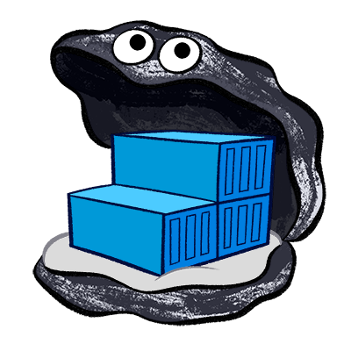



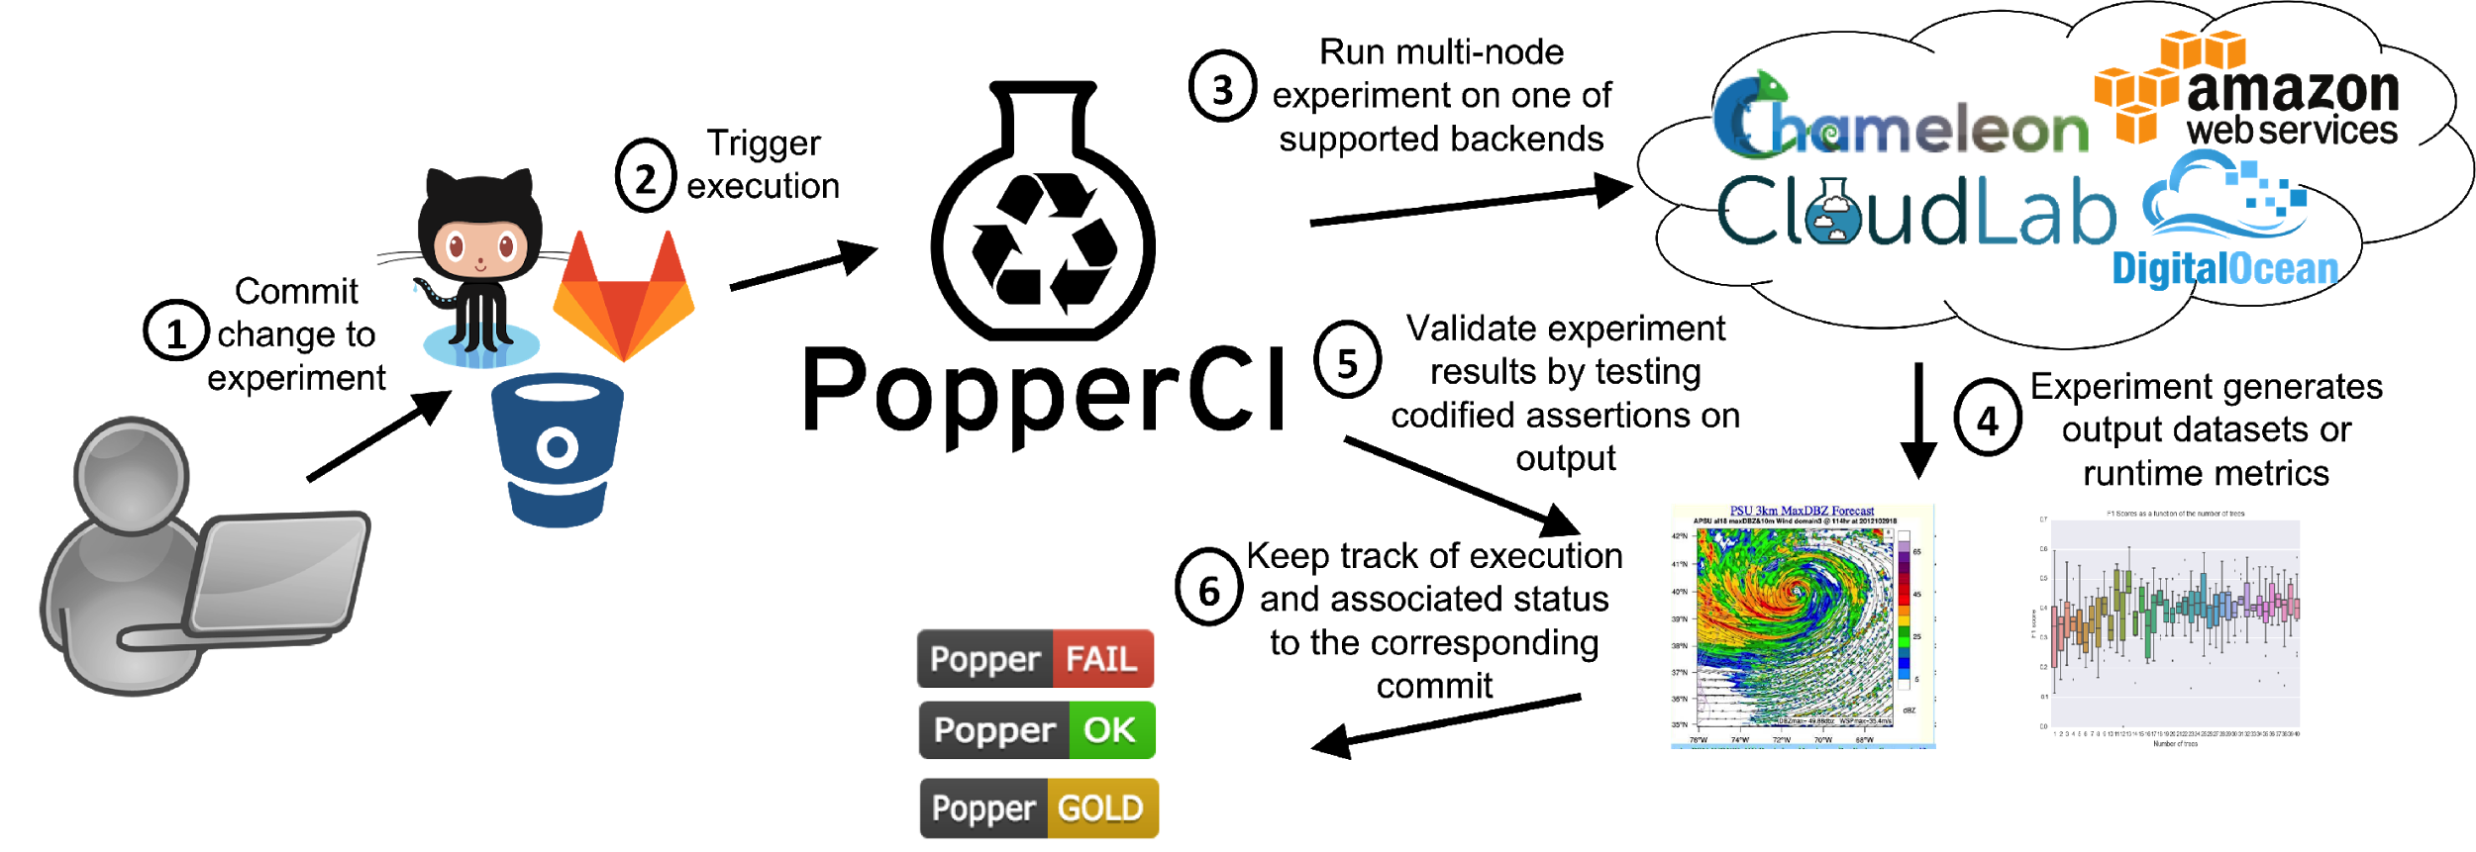
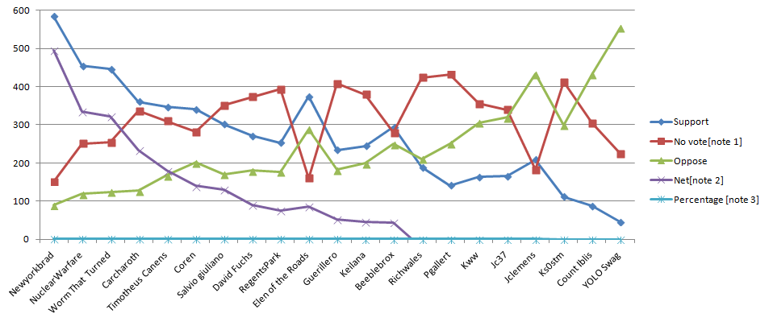
mypaper/pipelines/exp1
├── ansible/
│ ├── ansible.cfg
│ ├── machines.txt
│ └── playbook.yml
├── docker/
│ ├── Dockerfile
│ └── entrypoint.sh
├── enos/
│ └── reservation.yml
├── results/
│ ├── figure1.png
│ ├── postprocess.py
│ └── visualize.ipynb
├── run.sh
├── setup.sh
├── teardown.sh
├── validate.sh
└── vars.yml
provider:
type: chameleonbaremetal
image_name: CC-Ubuntu14.04-Docker
subnet: {name: shared-subnet1}
walltime: '00:30:00'
resources:
storage:
compute: 10
docker run --rm \
-e OS_AUTH_URL=$OS_AUTH_URL \
-e OS_TENANT_ID=$OS_TENANT_ID \
-e OS_TENANT_NAME=$OS_TENANT_NAME \
-e OS_PROJECT_NAME=$OS_PROJECT_NAME \
-e OS_USERNAME=$OS_USERNAME \
-e OS_PASSWORD=$OS_PASSWORD \
-e OS_KEYNAME=$OS_KEYNAME \
-v `pwd`/enos:/enos \
--workdir=/enos \
ivotron/enos:2.3.0 up

Slide 15
$ popper check exp1
Popper check started
Stage: setup.sh .....
Stage: run.sh ................
Stage: validate.sh ..
Stage: teardown.sh ...
Popper check finished
Status: SUCCESS
$ ls -l myrepo/
total 20K
-rw-r----- 1 ivo ivo 8 Apr 29 23:58 .git/
-rwxr-x--- 1 ivo ivo 210 Apr 29 23:58 experiments/
-rwxr-x--- 1 ivo ivo 206 Apr 29 23:58 paper/
$ popper ci travis
Created .travis.yml file.
$ ls -l myrepo/
total 20K
-rw-r----- 1 ivo ivo 8 Apr 29 23:58 .git/
-rw-r----- 1 ivo ivo 8 Apr 30 12:02 .travis.yml
-rwxr-x--- 1 ivo ivo 210 Apr 29 23:58 experiments/
-rwxr-x--- 1 ivo ivo 206 Apr 29 23:58 paper/

Slide 16



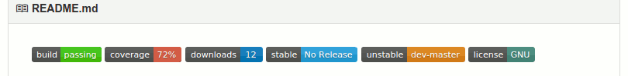

Slide 17




ACM/Popper Badges
Result Status | Artifacts | Re-executed By | ACM | Popper
Repeatability | Original | Original Author(s)
Replicability | Original | 3rd Party
Reproducibility | Re-implemented | Anyone

Slide 18
Agenda
12:15 – Introduction (scoping the BoF)
12:25 – Lightning talks
Kate Keahey, Carlos Maltzahn, Ivo Jimenez
12:40 – Discussion
1:05 – Survey

Slide 19

Survey
http://bit.ly/practical_repro_survey

